Slide 1
Production Possibility Curve (Frontier)

Slide 2
Production Possibility Curve (Frontier)
Since the resources are scarce, the society has to decide about the goods to produce: wheat, cloth, roads, electrical goods, for example. Once the nature of goods to be produced is decided, their quantities are to be decided too. Since resources are scarce, the nature of goods and the quantities to be produced have to be decided on the priorities and preferences set by the society.
The production possibility curve (frontier) is the graphic representation of alternative production possibilities in an economy. As the total productive resources of the economy are limited, the economy has to choose between different goods. The increase in the production of one good requires a decrease in the production of another. We can imagine various combinations of two goods (production possibilities) which the society can produce with its limited resources and the technology it has. Now the society has to choose one particular combination out of many. A curve which illustrates this choice is known as the production possibility curve (PPC). In other words, a curve, which shows various production possibilities that can be produced with given resources and technology is called PPC. In short, it depicts the society‘s menu of choice.

Slide 3
Assumptions of PPC
Factors of production are fixed
There is full employment in an economy
Constancy in technology
Short run basis
Substitution of factors of production

Slide 4
Production Possibility Schedule
The production possibility schedule shows the various combinations of different goods shaped by the given technology and factors of production. We used the example of an economy producing only two goods: guns and butter. Various combinations of the two goods using the given factors of production in different proportions can be listed in a schedule as given below:

Slide 5
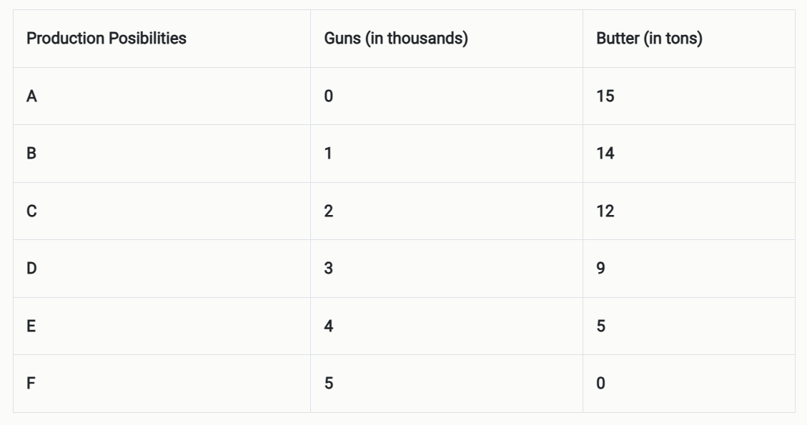
Production Possibility Schedule

Slide 6
According to the above schedule, if the economy devotes all its resources to the production of butter, it can produce, say, 15 tons of butter, but the production of guns will be zero (PP-A). Now, if the economy wants to produce 1 thousand guns it has to reduce the production of butter, says by 1 ton. It means the economy can produce 1 thousand guns and 14 tons of butter (PP- B). There can, thus, be a number of possibilities of guns and butter. Six such production possibilities (A, B, C, D, E and F) are shown in our example. Movements on production possibility from A to B, from B to C and so on, show that the rate of sacrifice of butter per thousands of guns increases as the production of guns steps up. This happens because of the law of diminishing returns, which states that, as we increase the production of a commodity successively by the same amount, there is a more than proportionate decline in toe production of the other commodity.

Slide 7
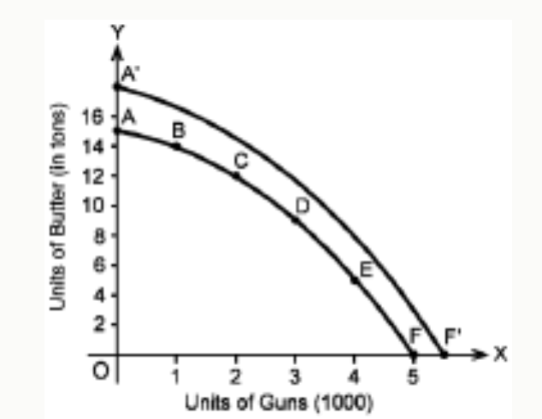
Production Possibility Curve

Slide 8
In Fig. 1-2, AF is the PPC, which is made by the summation of different points A, B, C, D, E, F (production possibilities) respectively. It slopes concave to the origin. It happens because if the society increases the output of guns, the society has to forgo one ton of butter (A to B). But, further to it, to have one more thousand of guns, we have to forgo 2 tons of, butter (B to C). This is called marginal rate of technical substitution of guns for butter and it goes on increasing. This is the reason why the shape of the PPC is concave to the origin.
The various points on the boundary of the PPC (A, B, C, D, E and F points in the diagram) represent the combination of goods that can be produced using the resources and technology that are available.
From these alternative production possibilities we learn that if we want to produce more guns we have to reduce the output of butter and vice versa. It means we can transform butter into guns or guns into butter. Thus, a PPC tells us that we can produce more of any one commodity by giving up some of the other. In other words, one commodity can be transformed into the other. That is why the PPC is termed transformation curve as well.
The rightward shift in the PPC (A‘F‘ in the diagram) indicates the increase in the productive capacity of the economy, which, in turn, depicts the problem of growth. In other words, an upward movement of the PPC would mean that the economy is in a position to produce a bigger basket of goods and services than it could do earlier.

Slide 9
Shifting of PPC:
The PPC will shift rightward or leftward under the following conditions:
i. Change in resources. Resources may increase or decrease in an economy. If resources are increased, we can produce more of both goods. Accordingly, PPC shifts to the right as in the figure. On the contrary, if resources are decreased, we can produce less of both goods. Accordingly, PPC shifts to the left as in the figure.
ii. Change in technology. When technology changes and improved and efficient technology is used in the production of both goods, it results in greater production of both goods (i.e., guns and butter) with the same resources. Accordingly, PPC shifts to the right as in the figure.

Slide 10
